Slide 1
-LAN,WAN,MAN

Slide 2
Syllabus
Define the terms LAN,MAN,WAN
Difference between broadcast media access& non-broadcast media access
LAN technologies (Ethernet , token ring)
LAN Topologies
Devices (NIC, Hub, Switch , Router) and their operating layers
Effects & causes of network
Factors of total throughput
Transmission media (STP, UTP, Coaxial, Optical fiber, wireless)
Typical areas covered by LAN, MAN, WAN
MAN technologies (SDH, Leased line..)
WAN technologies (FR, ATM)
CSMA/CD & MAC

Slide 3


Computer Network
  Group of computers and other devices connected by some type of transmission media
  Communication mechanism between two or more computers using a common protocol.
  System that transmits any combination of voice, video and/or data between users.

Slide 4
Network Organization
Method by which the user's PC accesses it.
Centralized control – Client/Server
Distributed control – Peer-to-peer

Slide 5
A Network Consists of,
Clients
Server (if Client/Server network is used)
Network components (NIC/Hub/Switch/Router)
Transmission media
Desktop Operating Systems (Windows 95/98/Me, Windows 2000 Professional, Windows XP Home Edition, Windows XP Professional , Vista)
Network Operating System (NOS) (If Client/Server network is used. Ex: Windows NT/2000/2003 server, Linux, Solaris etc…)
Peripherals (Printers, Scanner...)

Slide 6
Network Components
The network components constitute the hardware that is required to actually build your network.
According to geographical dimension and access method of the network, the network components need to be chosen.
Network components are:
  Network Interface Card (NIC)
  Hubs
  Switches
  Routers

Slide 7

The Open Systems Interconnection (OSI) reference model

Slide 8
The 7 OSI Layers
Application
7
Presentation
6
Session
5
Transport
4
Network
3
Data Link
2
Physical
1

Slide 9
OSI summery
Application
Network Processes to Application
7
Presentation
Data Representation
6
Session
Interhost Communication
5
Transport
End-to-end connection
4
Network
Address and Best path
3
Data Link
Access to media
2
Physical
Binary transmission
1

Slide 10
3.Network Layer
As the lowest three layers are network dependant their functionality varies from network to network.
The network layer is responsible moving data through a set of networks (internetwork)
Generally Network Layer provides routing and related functions that enable multiple data links to be combined into an internet work. It includes functionality such as network addressing and routing.
  Routers use routing protocols to determine the best path for data transfer

Slide 11
2.Data Link Layer
LAN Standards used by the data-link layer include,
  IEEE 802.3 / Ethernet
  IEEE 802.5 / Token Ring
  FDDI (Fiber Distributed Data Interface)
WAN Protocols used by the data-link layer include,
  Frame relay,ATM,X.25
  Point to Point Protocol (PPP)

Slide 12
Duplex
A duplex communication system is a system composed of two connected parties or devices which can communicate with one another in both directions.
(The term duplex is not used when describing communication between more than two parties or devices.)

Slide 13
Half duplex
  A half-duplex system provides for communication in both directions, but only one direction at a time (not simultaneously). Typically, once a party begins receiving a signal, it must wait for the transmitter to stop transmitting, before replying.
  Ex: walkie-talkie
      style two-way radio, wherein one must use "Over" or another previously designated command to indicate the end of transmission, and ensure that only one party transmits at a time, because both parties transmit on the same frequency.

Slide 14
Full Duplex
  A full-duplex system allows communication in both directions, and unlike half-duplex, allows this to happen simultaneously.
  Land-line telephone networks are full-duplex since they allow both callers to speak and be heard at the same time.
  A good analogy for a full-duplex system would be a two lane road with one lane for each direction.
  Examples: Telephone, Mobile Phone, etc.

Slide 15
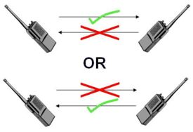

Half duplex & Full Duplex
Half Duplex Full Duplex

Slide 16
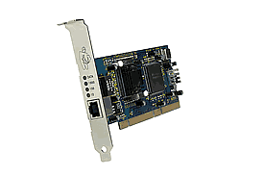
NIC
LEDs
RJ45
A Network Interface Card (NIC) is a circuit board that plugs into both clients and servers and controls the exchange of data between them.
  A specific software ("driver") must be installed (depending on the make of the NIC).

Slide 17
NIC..
physical transmission medium, such as twisted pair or coaxial cable, interconnects all network interface cards to network hubs or switches.
Ethernet and Token Ring are common network interface cards.
Today's cards support
    10BaseT and
    100BaseT with automatic recognition.

Slide 18
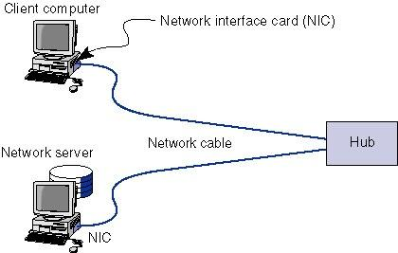
NIC Connection

Slide 19
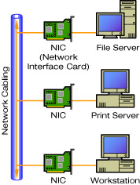
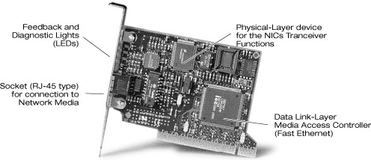
NIC

Slide 20
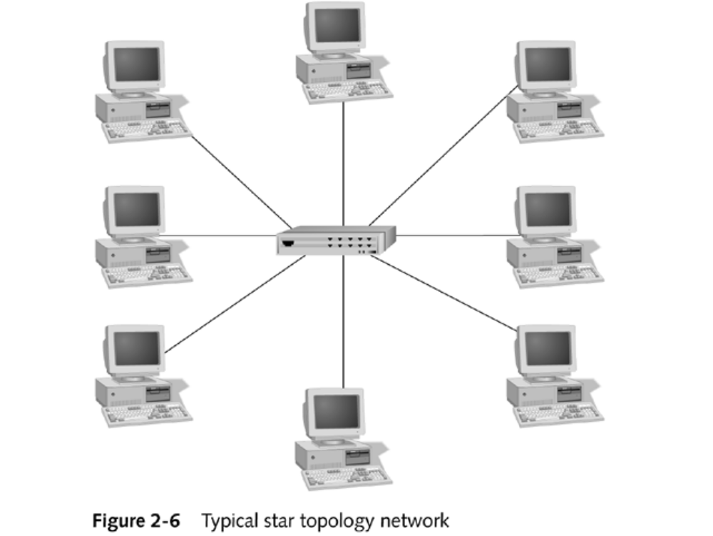



Hub
Standard Ports
HP ProCurve Compact 10Base-T Hub 8
Crossover Port
Hubs connect all computer LAN connections into one device.
They are nothing more than multi-port repeaters. Hubs cannot determine destinations; they merely transmit to every line attached in a half-duplex mode

Slide 21
Hub..
  Multi-port repeater
    Repeater operating at bit level
    Repeat received bits on one interface to all other interfaces
  Share the available bandwidth.
  Use CSMA/CD standard
  Forward all traffic to all hosts and is therefore inefficient.
  Each connected LAN referred to as LAN segment
  Hubs do not isolate collision domains: node may collide with any node residing at any segment in LAN
  Effectively a physical layer device

Slide 22
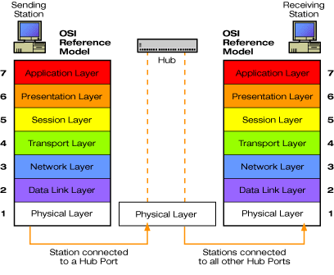
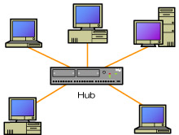
Hub..
NIC

Slide 23
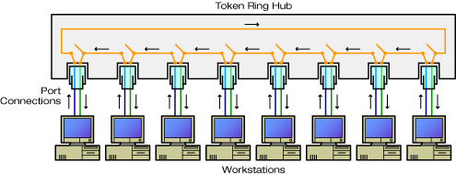
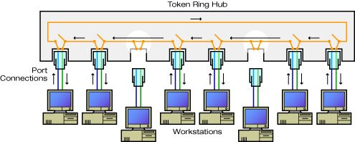
Hub..

Slide 24
Hub..
Advantages:
  simple, inexpensive device
  Provide an easy way to connect network cables and expand a network.
  Act as repeaters or amplifiers to prevent attenuation.
  extends maximum distance between node pairs (100m per Hub)
Hub Limitations:
  single collision domain results in no increase in max throughput
  individual LAN restrictions limits on number of nodes in same collision domain.

Slide 25
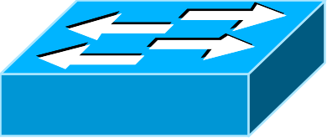
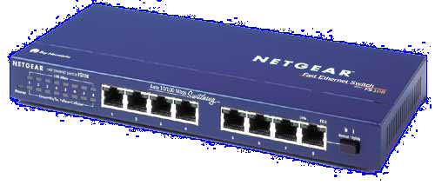
Switch
Switches connect all computer LAN connections, the same as hubs do.
The difference is that switches can run in full-duplex mode and
are able to direct and filter information to and from specific destinations.
Data Link Layer devices:
  operate on Ethernet frames, examining frame header and selectively forwarding frame based on its destination

Slide 26
Switch..
Each port determines MAC addresses connected to itself
  MAC Address List within switch determines forwarding behavior
Switches are intelligent hubs
  -providing dedicated connection and bandwidth between clients on a LAN.
A switch gives any device on the network the full bandwidth instead of sharing the available bandwidth.

Slide 27
Switch..
Advantages:
  Isolates collision domains resulting in higher total max throughput.
  Can connect different type Ethernet since it is a store and forward device
layer 2 (frame) forwarding, filtering using LAN addresses
Individual hosts, star-connected into switch
  Ethernet, but no collisions!

Slide 28
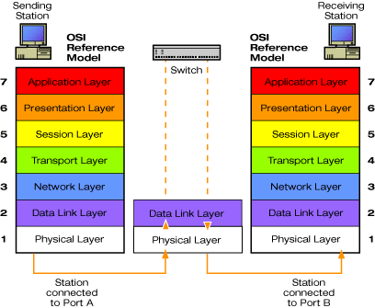
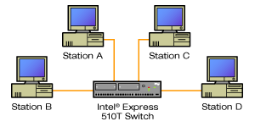
Switch..

Slide 29

Router
A router is a device that forwards data packets from one network to another.
Routers are able to route and filter information to different networks.
  Convert data structure from one media to another, for example Ethernet <=> ISDN.
Mainly used for interconnecting similar or different types of LANs.
  For example two different networks like a LAN and the Internet
Some routers can automatically detect problems and redirect information around the problem area. These are called "intelligent routers."
Network Layer devices:

Slide 30
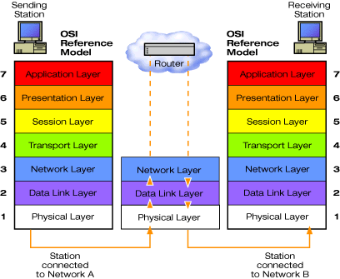
Router..

Slide 31
Combining Hubs, Switches, and Routers in a Hierarchy
WAN
Router
Switch
Switch
Switch
Hub
Hub
Hub
Hub
Hub

Slide 32

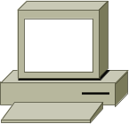

Workgroup with Ethernet Switch
Workgroup with Ethernet Hub
To ISP and Internet
Floor 3 LAN
Workgroup with Ethernet Switch
Workgroup with Ethernet Hub
Floor 2 LAN
Router
Connecting Offices and Departments
Workgroup with Ethernet Switch
Workgroup with Ethernet Hub
Floor 1 LAN
Notes:
Connecting Offices and Departments
Clients with NICs installed
Servers
Hubs
Switch
Cabling
Network operating system software (for example, Windows NT, Windows 95/98, Windows 2000, Novell NetWare, LANtastic, and AppleShare)
Router for shared Internet access (optional)

Slide 33




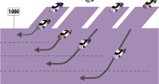
HUB Vs SWITCH
10 Mbps Shared Ethernet
10 Mbps Switched Ethernet
100 Mbps Shared Fast Ethernet
100 Mbps Switched Fast Ethernet
1000 Mbps Switched Gigabit Ethernet
Advantages of Switches
• Dedicated bandwidth and full-duplex operation • Reduce data latency
• Increasing distance • Improved network performance • Network security
• Special ports for connecting servers and cascading switches

Slide 34

Switches vs. Routers
both store-and-forward devices
  routers: network layer devices (examine network layer headers)
  switches are Data Link Layer devices
routers maintain routing tables, implement routing algorithms
switches maintain MAC address tables, implement filtering, learning and spanning tree algorithms
Switch

Slide 35

Network Overview
A network can be defined by its geographical dimension and
by the method by which the user's PC accesses it.

Slide 36
Network Organization
by its geographical dimension
  Local Area Networks (LAN),
  Metropolitan Area Networks (MAN),
  Wide Area Networks (WAN)

Slide 37
Local Area Network (LAN)
Network of computers and other devices confined to relatively small space
LANs involving many computers are usually client/server based
A connection between a small group of workstations and peripherals
LANs are the basic building block of networks

Slide 38
Local Area Network (LAN)
LAN

Slide 39

Metropolitan Area Network(MAN)
MANs are hybrids between LANs and WANs
Use WAN technology to connect the LANs
Allows internetworks to span whole cities, rather than just buildings

Slide 40

WWide Area Network(WAN) Network (WAN)
WANs span countries, continents, and
the world
  High capacity and High capital costs
WANs are shared between thousands of customers
  Similar to the Telephone network.

Slide 41
Wide Area Network (WAN)
LAN B
WAN
DCE
LAN A
DCE
DCE – Data Communication Equipment

Slide 42
LAN (Local Area Network)
Typical areas covered by LAN
Transmission media deployed in LAN
LAN Topologies
Technologies used in LAN
LAN Access Control
Advantages & Disadvantages

Slide 43


Typical areas covered by LAN
Network of computers and other devices confined to relatively small space like,
        A company site
        A home
        An office & etc

Slide 44
LAN Topologies
  Topology Describes the physical layout of a network
  It shows how are the computers and devices connected?
  Issues of use of different LAN Topologies
  Basic shape of design
    Building/Physical constraints
      Multiple floors
      Distances

Slide 45
LAN Topologies..
The common topologies for LANs are (Basic shape of design),
    BUS Topology
    RING Topology
    TREE Topology
    STAR Topology
    Extended STAR Topology

Slide 46
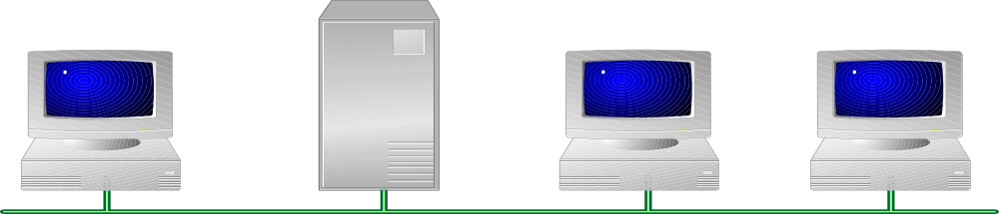
BUS Topology
12
√
37
13
09
X
X
To: 37 Data:xxxx
One cable connects all components
  Cable may be straight or “snake” through the building
  Individual devices are connected on branches of the backbone
Each message is sent to all computers
Only the addressed computer responds to the message

Slide 47
BUS Topology..
All stations attach, through appropriate hardware interfacing known as a tap, directly to a liner transmission medium called BUS.
A full duplex operation between the station and the tap allows data to be transmitted on to the bus and receives data from the bus.
A transmission from any station propagates the length of the medium in both directions and can be received by all other stations.

Slide 48
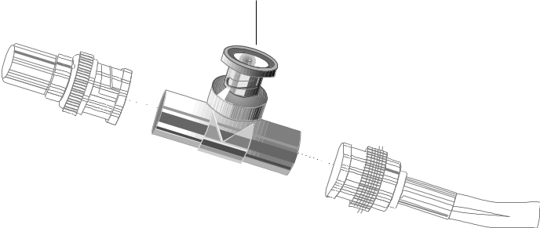
10Base-2 Bus LANs
Most Bus LANs are connected using 10Base-2 Coaxial Cable
  10Mbps, baseband transmission, 200m max
BNC-type connections
  Use a ‘T’ to make a spur to connect a workstation
Terminators
  All cable ends must be terminated (50W) to prevent reflections

Slide 49
Bus Pros and Cons
Advantages
Simple
  “Plug and play”
Cheap
  Mostly all cables
  Cables are relatively inexpensive
Linear arrangement
  Just run your backbone in a path that goes near the workstations
Disadvantages
Many single-point failure modes
  Broken backbone
  Any unplugged computer that isn’t terminated
Difficult to trace errors
  All one big “wire”
  Problem could be anywhere
Limits on cable length seriously constrain size
  Repeaters needed

Slide 50
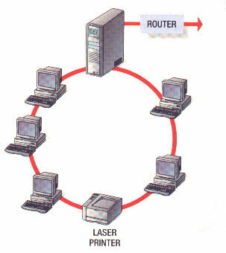
RING Topology
Here the network consists of a set of repeaters joint by point-to-point links in a closed loops. (The repeater is a device, which receive data from one link and transmit to the other link without buffering.)

Slide 51
RING Topology..
Links are unidirectional;
  hence the data circulate in only one direction.
  Each station attached to the repeater can transmit data into the network.
As a frame circulates past all the other stations, the destination station recognizes its address and copies the frame into a local buffer as it goes by.
The frame continues to circulate until it returns to the source station, where it is removed.

Slide 52

STAR (Hub) Topologies
Logically, the same as a bus
  Medium is still shared by all stations at all times

Slide 53
STAR Topology..
Here each station is directly connected to a common central node referred to as a star coupler.
Each station attaches to the central node via two point-to-point unidirectional links,
  one for transmission and
  one for reception in opposite directions.
There are two modes of operations, that is Central node can operate either broadcast mode or switching mode. Broadcast mode is considered logically as a bus.

Slide 54
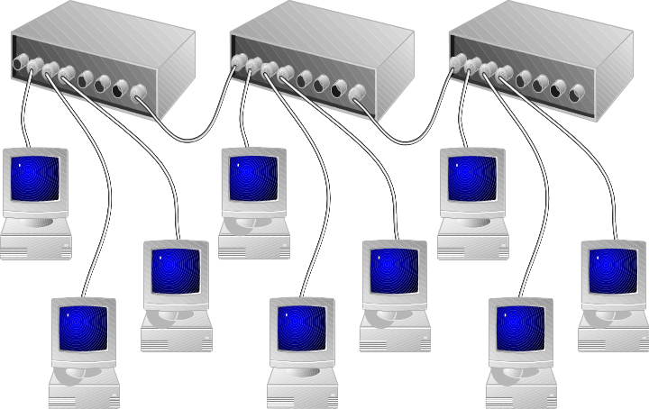
Extended STAR Topology
(Star-Bus)
Connect multiple stars (hubs) together in a bus
  Isolates individual groups from each other
  Hierarchical
Logically, still one single shared medium
Need to use crossover port or crossover cable for Hub-to-Hub link
HP ProCurve Compact 10Base-T Hub 8
Crossover Port
Hub
Tx
Rx
Rx
Tx
NIC
Hub
Tx
Rx
Rx
Tx
Tx
Rx
Hub

Slide 55
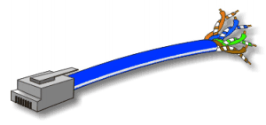
Star (Hub) Pros and Cons
Advantages
Termination is no longer an issue
  An un-terminated line only effects communication to one device
  Can’t bring the network down by unplugging your network connection
Expansion is easier
  Active hubs reduce loading limitations
Easier troubleshooting
  Isolated connections
Disadvantages
Single-point failure
  If the hub goes down, all is lost
More cable needed
  All cables must reach from workstations to the hub

Slide 56
Shared media LAN Technologies
According to the technology used in LAN
there are several types,
  1. Ethernet (CSMA/CD, BUS)
  Standard IEEE 802.3
  2. Token Ring (control token)
  Standard IEEE 802.5
  3. FDDI (Fiber Distributed Data Interface)
  Also,
      Fast Ethernet
      Gigabit Ethernet
      Fiber channel
      Wireless LAN

Slide 57
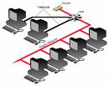

Technologies used in LAN
Ethernet Token ring

Slide 58
1. Ethernet
Is a contention media access method that allows all hosts on a network to share the same bandwidth of a link
  Is a very common LAN technology
  IEEE 802.3 defines a bus topology
  The Ethernet specification describes a carrier sense multiple access/collision detect (CSMA/CD) LAN
  Ethernet is a family of frame-based computer networking technologies for local area networks (LANs). It defines a number of wiring and signaling standards for the physical layer, through means of network access at the Media Access Control (MAC)/Data Link Layer, and a common addressing format.

Slide 59
Ethernet..
  It has been in use from the 1990s to the present, largely replacing competing LAN standards such as token ring, FDDI.
  Ethernet is a LAN technology, which uses CSMA/CD medium access control mechanism in a physical or logical bus topology.
  In recent years, Wi-Fi, the wireless LAN standardized by IEEE 802.11, is prevalent in home and small office networks

Slide 60
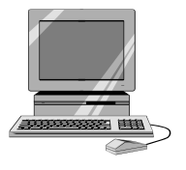

Ethernet (CSMA/CD, BUS)..
World’s most popular LAN technology (over 85% of ports)
25 years old and still evolving
Shared access media -- stations compete for access
I want
to send!
I want
to send!
I want
to send!

Slide 61
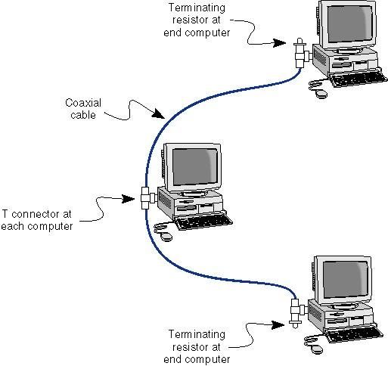
Ethernet (CSMA/CD, BUS)..

Slide 62
2. Token Ring
Token ring is the most commonly used LAN technology for ring topology LANs, which is based on the use of a small frame, called a token.
Token ring uses Control Token as the medium access control mechanism and it refers the IEEE 802.5 standards.

Slide 63
Token Ring Operation
A host with data to transmit must wait for token before sending.
Host seizes the token and sends data frame.
Frame
Host waiting to send
Frame
Token
Destination

Slide 64
3. FDDI
(Fiber Distributed Data Interface)
FDDI is an extension to token ring technology, which is design for both LAN and WAN application using fiber as the medium of transmission.
The basic difference with Token ring is FDDI uses two rings known as primary and secondary, where secondary is activated in a failure of the primary.

Slide 65
FDDI.. (Fiber Distributed Data Interface)
FDDI is a token ring network designed for reliable LAN or WAN use
FDDI has 2 rings oriented in opposite directions. In normal operation only one ring is used.
Token or Data frame circulates ring.

Slide 66
Token Ring & FDDI Operation
Wait
-MAC Protocol
Token received
No
yes
Message ready?
Ignore
token
yes
Capture token:
Change it to start-of frame
Insert a new
token
Begin pkt
transmission
Last bit of pkt
Transmitted?
yes
yes
Leading edges
Returned?
No
No

Slide 67
Other Technologies
Fast Ethernet & Gigabit Ethernet
  The extension of 10 Mbps CSMA/CD to higher speeds is a logical strategy.
Fiber channel
  This provides low cost, easily scalable approach to achieving very high data rates in local user
High speed wireless LANs
  Wireless LAN technology and standards have at last come of age, and high speed standards.

Slide 68
Operating speeds of LAN Tech.
Ethernet | 10Mbps
Fast Ethernet | 100Mbps
Gigabit Ethernet | 1Gbps, 10Gbps
Fibre Channel | 100Mbps-3.2 Gbps
Wireless | 1 Mbps-54 Mbps

Slide 69
Congestion on a network
Cause
  Increased traffic
  High demand for access
Effect
  Increased collisions
  Slow response
  Time-outs

Slide 70
Cause of Congestion on a network
  Increased traffic
    -When downloading or uploading files
  High demand for access
    -increasing no. of users at a time

Slide 71
Effect of Congestion on a network
  Increased collisions
    -due to high traffic
  Slow response
    - Mean no. of repeat transmitting increased
    -once request something, can get answer late
  Time-outs
    -Due to discarding of packets when high traffic

Slide 72
Effective Factors to reduce total throughput / BW available within a LAN
Ethernet collisions
High volume of users
Broadcast storms
Inadequate physical segmentation
Increased traffic
Data backup procedures
Faulty cable
EMI (Electro Magnetic Interference)

Slide 73


Broadcast storms
A state in which a message that has been broadcast across a network results in even more responses, and each response results in still more responses in a snowball effect. A severe broadcast storm can block all other network traffic, resulting in a network meltdown. Broadcast storms can usually be prevented by carefully configuring a network to block illegal broadcast messages.

Slide 74
Inadequate physical segmentation
A network segment is a portion of a computer network where in every device communicates using the same physical layer.
Devices that extend the physical layer, such as repeaters or network hubs, are also considered to extend the segment.
However, devices that operate at the data link layer level or higher create new physical layers and thus create rather than extend segments.

Slide 75
EMI (Electro Magnetic Interference)
EMI is the intrusion of outside electromagnetic signals that affect the signal being sent over the network media
When outside interference encroaches on the network signal, the receiving computer has difficulty interpreting the signals.
  Copper wire is specially susceptible for EMI
  Coaxial cable’s thick outer jacket offers some protection from EMI as done by STP
  UTP fairly vulnerable to EMI, but twisting of the wire pairs inside the cable helps to reduce it.(best choice)

Slide 76
LAN Access control
There are two types of LAN access control Standards according to the IEEE 802 Standards they are,
  MAC
    -(Medium Access Control (Media Access Control)
  CSMA/CD
    -(Carrier Sensing Multiple Access/ Collision Detection)

Slide 77
MAC
There are two types of Media access control methods, they are,
  CSMA/CD
    Supported to Ethernet Technology
  Control token
    Supported to Token ring, FDDI Technology

Slide 78
MAC
Media Access Control technology provides unique identification and access control for computers on an Internet Protocol (IP) network.
In wireless networking, MAC is the radio control protocol on the wireless network adapter.
MAC works at the lower sub layer of the data link layer (Layer 2) of the OSI model.
It provides addressing and channel access control mechanisms that make it possible for several terminals or network nodes to communicate within a multipoint network, typically a (LAN) or (MAN).

Slide 79
CSMA/CD
A carrier sensing scheme is used by CSMA/CD. The method of operation of CSMA/CD is,
  A transmitting data station that detects another signal while transmitting a frame,
  Stops transmitting that frame, transmits a jam signal,
  And then waits for a random time interval (known as "backoff delay" and
  determined using the truncated binary exponential backoff algorithm) before trying to send that frame again.

Slide 80
CSMA/CD
Start
There is data from
User to send
Assemble a frame
Phy. addresses are
Used (MAC address)
Attempt 1
Is some other station
Transmitting?
Yes
No
Recovered
Transmit 1st bit of
The frame
Yes
Collision
Recovery
subalgorithm
Collision detected?
No
Transmit next
bit of The frame
No
Transmission finished?
Not Recovered
End
Yes
Frame transmitted successfully
End
Frame transmission fail
Due to collision

Slide 81
Control token
Operation
Wait
Token received
No
yes
Message ready?
Ignore
token
yes
Capture token:
Change it to start-of frame
Insert a new
token
Begin pkt
transmission
Last bit of pkt
Transmitted?
Leading edges
Returned?
yes
yes
No
No

Slide 82
Metropolitan Area Network (MAN)
Allows internetworks to span whole cities, rather than just buildings
It serves network in multiple sites within the city’s limits or metropolitan boundary.
Eg: University
local government office
Use WAN technology to connect the LANs

Slide 83
Technologies used in implementing MAN
Line- of –sight microwave
Synchronous Digital Hierarchy (SDH)
Leased line

Slide 84
Wide Area Network (WAN)
WANs span countries, continents, and
the world
  High capacity and High capital costs
WANs are shared between thousands of customers
Eg: -Internet
-a network in a international company with
offices in several countries

Slide 85
Technologies used in implementing WAN
Frame Relay (FR)
Asynchronous Transfer Mode (ATM)
Circuit switching
Packet switching

Slide 86
Circuit Switching
Dedicated communications path established for the duration of the conversation
e.g. telephone network

Slide 87
Packet Switching
Data sent out of sequence
Small chunks (packets) of data at a time
Packets passed from node to node between source and destination
Used for terminal to computer and computer to computer communications

Slide 88
Frame Relay
Packet switching systems have large overheads to compensate for errors
Modern systems are more reliable
Errors can be caught in end system
Most overhead for error control is stripped out

Slide 89
Frame Relay (FR)
The designers of frame relay aimed at a telecommunication service for cost-efficient data transmission for intermittent traffic between (LANs) and between end-points in a (WAN). Frame relay puts data in variable-size units called "frames" and leaves any necessary error-correction (such as re-transmission of data) up to the end-points. This speeds up overall data transmission.

Slide 90
Asynchronous Transfer Mode (ATM)
Evolution of frame relay
Little overhead for error control
Fixed packet (called cell) length
Anything from 10Mbps to Gbps
Constant data rate using packet switching technique

